Slide 1

Exploratory Data Analysis
G2M Insight for Cab Investment Firm
20th August 2024
Presented to
XYZ Company

Slide 2

Agenda
Executive Summary
Problem Statement
Approach
EDA
EDA Summary
Recommendations

Slide 3
Executive Summary
Objective:
XYZ is considering an investment in the U.S. cab industry, focusing on two companies. The goal is to analyze market trends, customer profiles, and financial metrics to identify the best investment opportunity.
Key Insights:
Market Share: One company shows a consistently higher market share, particularly in key metropolitan areas.
Customer Demographics: Significant differences in customer profiles (age, income) between the two companies suggest targeted marketing strategies.
Financial Performance: Analysis of cost, revenue, and profit margins indicates one company has a more efficient pricing model.
Seasonal Trends: Usage patterns vary significantly by season and region, with notable peaks and troughs that could impact profitability.
Conclusion:
Based on the analysis, Yellow Cab is recommended as the better investment opportunity due to its larger market share, stronger financial performance, and more lucrative customer segments.

Slide 4
Problem Statement
The U.S. cab industry has seen significant growth, with multiple key players competing for market share. As XYZ plans to enter this market, understanding the competitive landscape and identifying the best investment opportunity is crucial.
Multiple datasets with diverse information (customer demographics, financial transactions, city-level data) need to be integrated and analyzed to provide actionable insights.
Key Questions:
Which company has the highest market share and customer satisfaction?
What are the demographic and economic characteristics of the customer base for each company?
Which company demonstrates stronger financial performance, considering metrics like profit margins, cost efficiency, and revenue growth?
How do seasonal and regional variations impact the performance of each company?

Slide 5
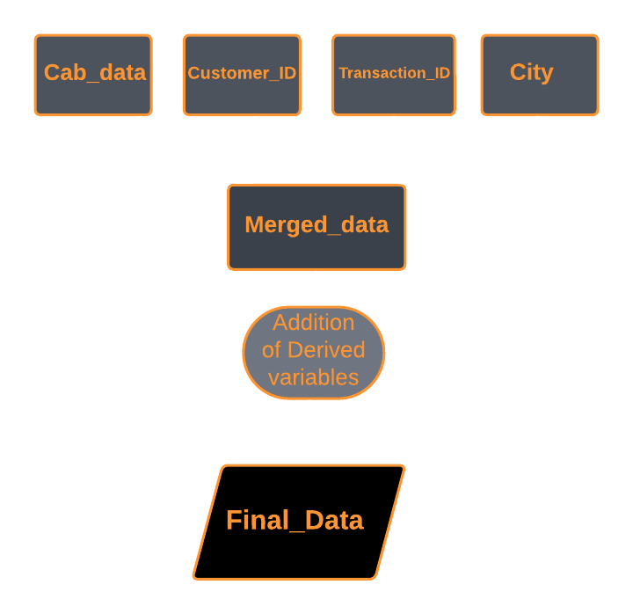
Data Overview
Four datasets were provided, covering cab transactions, customer demographics, city, transaction-customer mapping
Time Period of data is from 31/01/2016 to 31/12/2018
The datasets were merged based on common identifiers like Customer ID, Transaction ID to create a comprehensive master dataset.
New variables such as profit margins, price per kilometer, and categorized age and income groups were created to enhance analysis.
The final data set consists of 359392 observations and 22 features ( including 8 derived features)
Analytical Techniques:
Descriptive Statistics
Data Visualization
Comparative Analysis

Slide 6
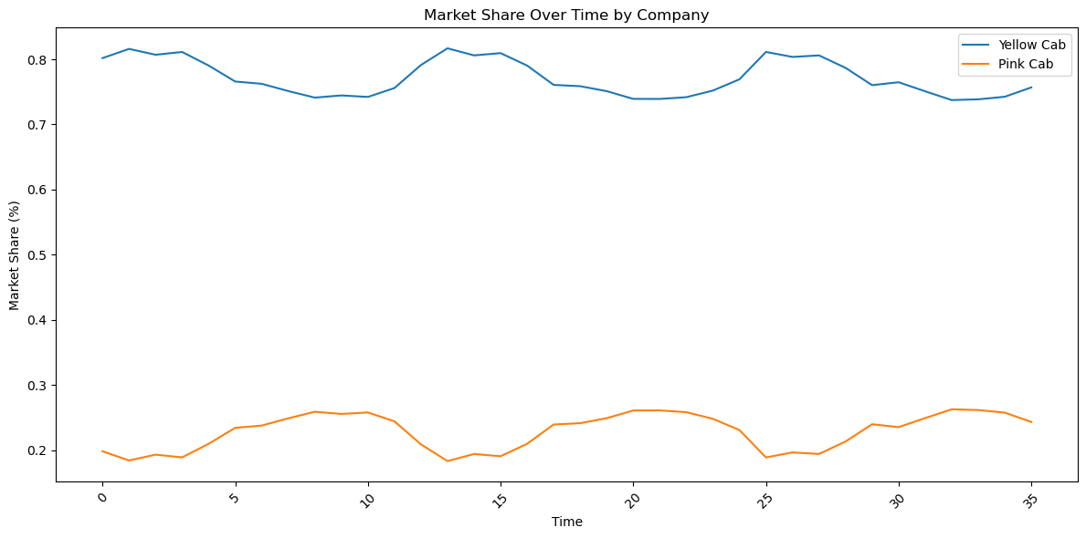
Market Share Analysis
Yellow Cab has a larger market share compared to Pink Cab, with a higher number of users and transactions.

Slide 7
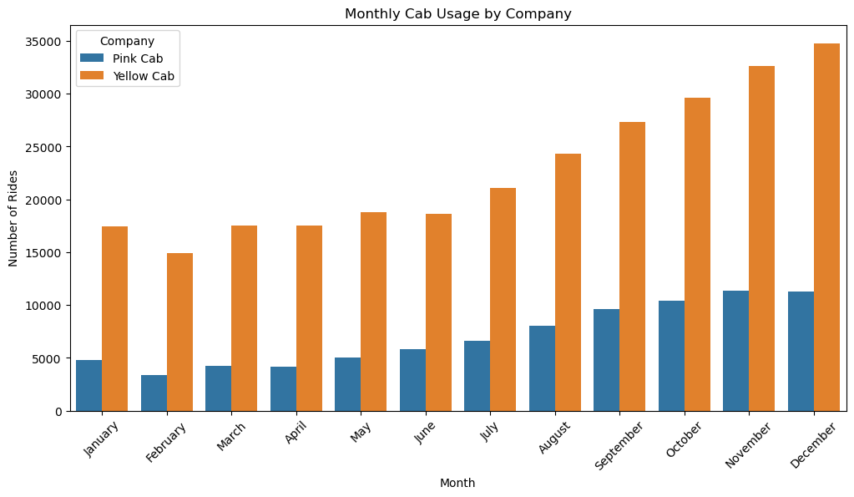
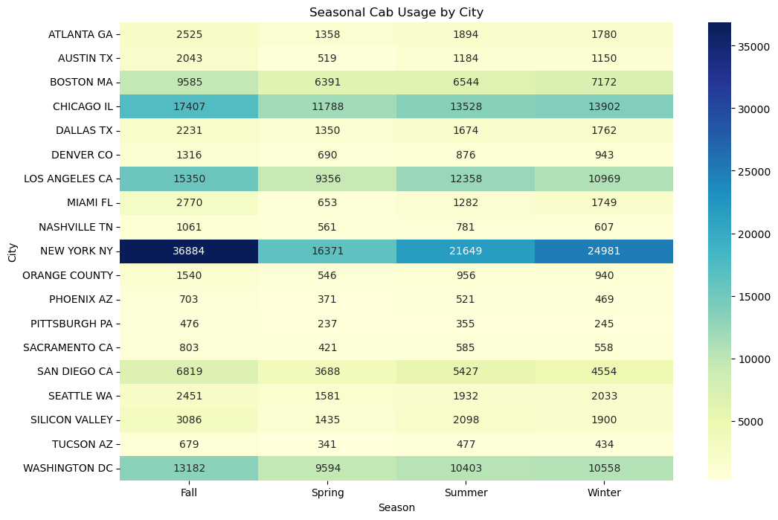
Seasonality Analysis
There is a seasonal effect on cab usage, with peaks towards the end of the year.
Across all cities, cab usage peaks during the fall season, indicating a higher demand for transportation during this time

Slide 8
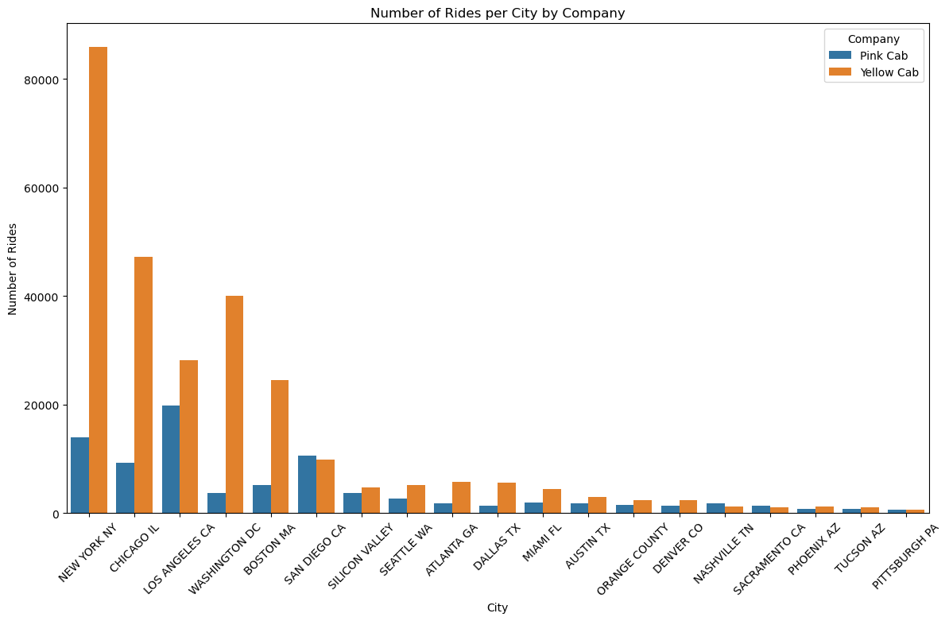
City Analysis
New York City has the highest number of cab users, making it a critical market. Yellow Cab dominates most cities, but Pink Cab has a slight edge in specific areas like San Diego, Nashville and Sacramento.

Slide 9
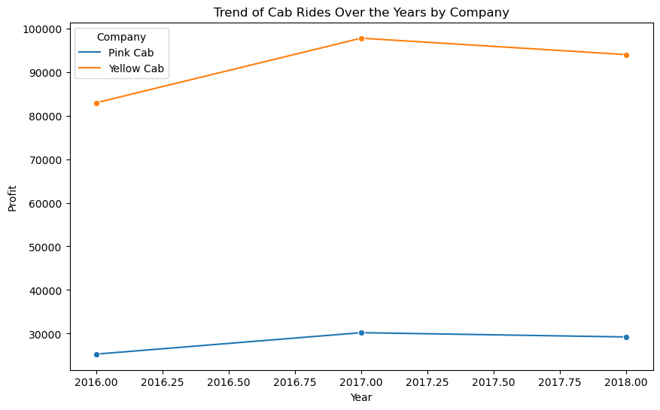
Annual Analysis
Yellow cab and pink cab experienced a steady rise in profit from 2016 to 2017. Profit was at its peak in 2017 but declined afterwards.

Slide 10
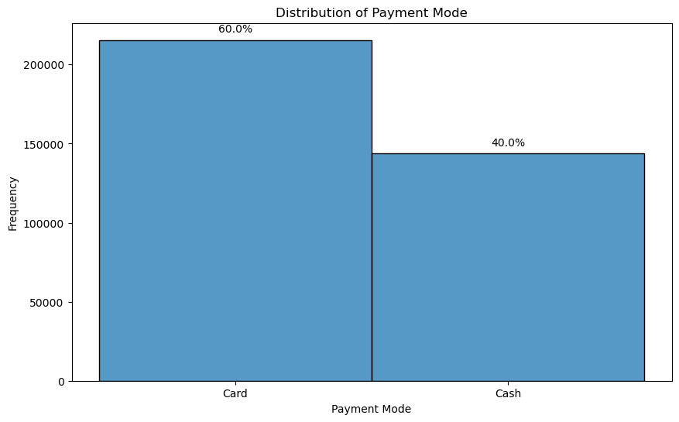
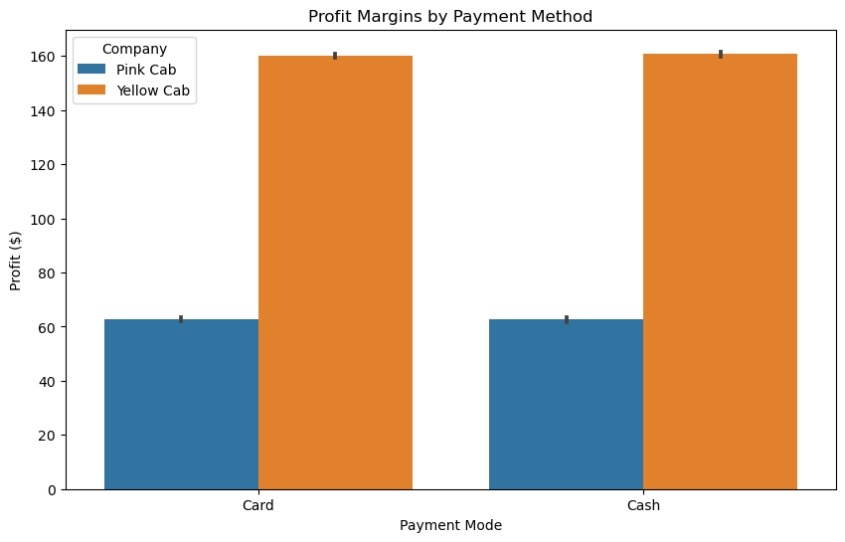
Payment method Analysis
60% of users prefer to pay by card, with Yellow Cab seeing higher card payments compared to Pink Cab.

Slide 11
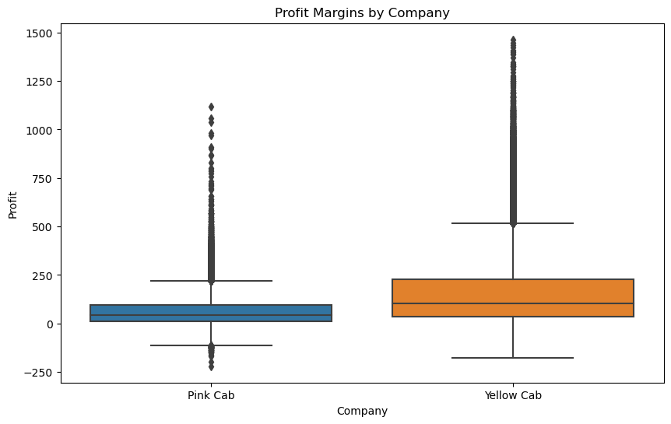
Profitability Analysis
Yellow Cab consistently shows higher profit margins across the board, indicating better financial performance

Slide 12
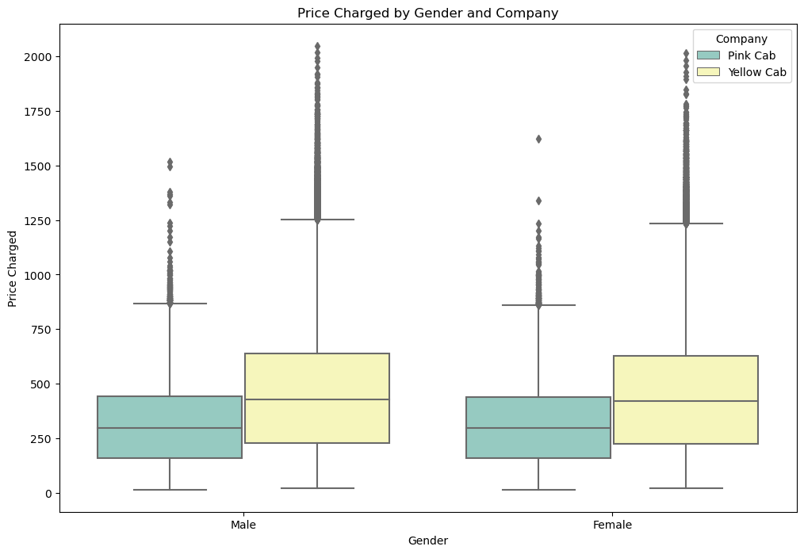
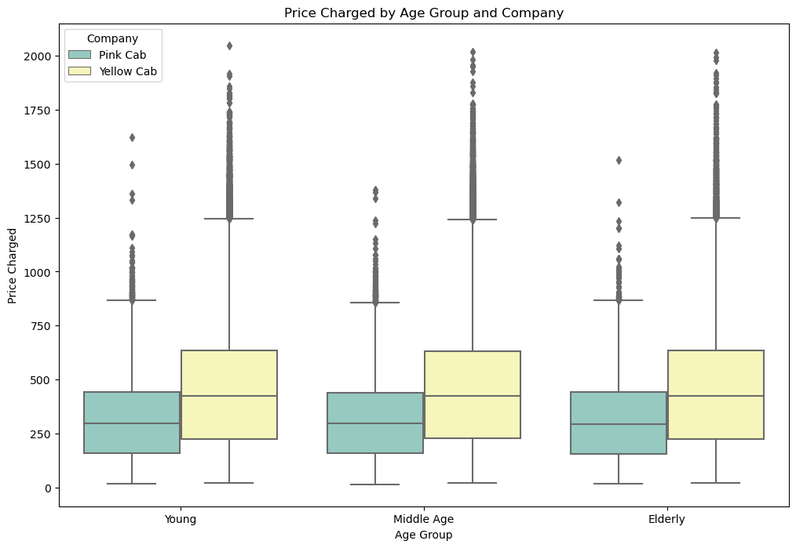
Demographics Analysis
Prices are charged uniformly regardless of gender or Age group

Slide 13
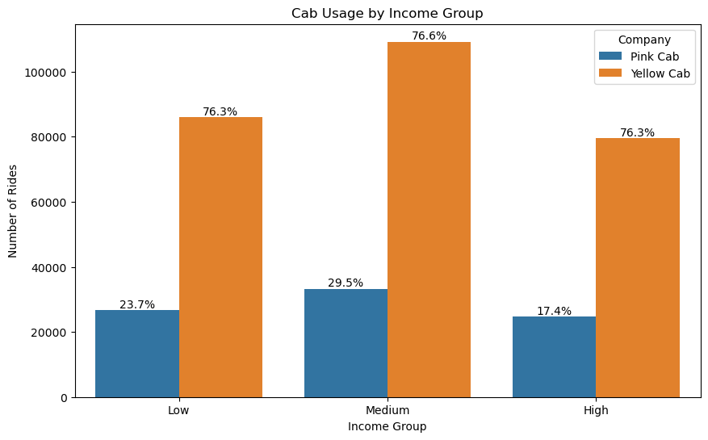

Customer Segmentation Analysis
Both companies serve mostly medium-income earners, but Yellow Cab has a more diverse customer base, including more high-income users

Slide 14
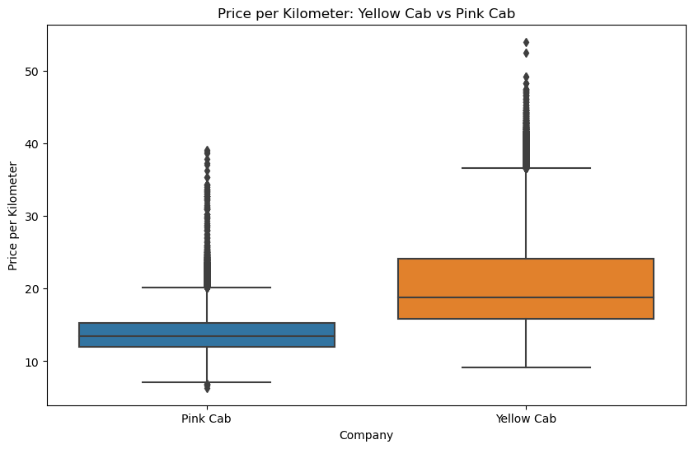
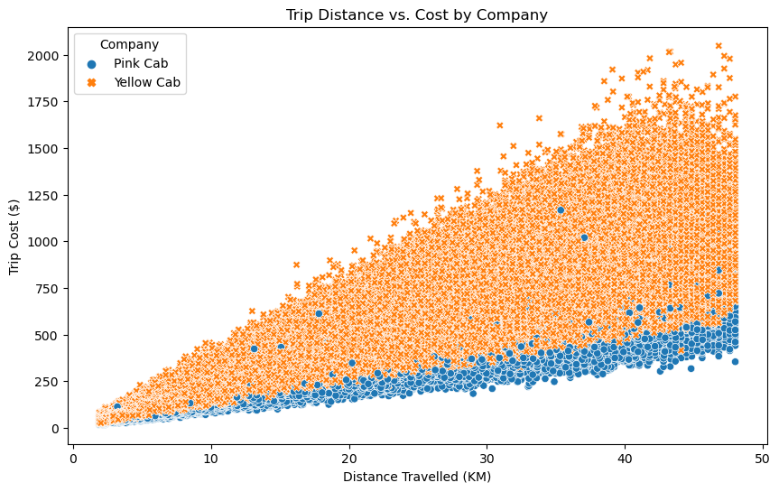
Correlation Analysis
There is a strong positive correlation between kilometers traveled and cost. Yellow Cab charges more per kilometer compared to Pink Cab

Slide 15
Key Findings
Summary of Insights:
Yellow Cab has a larger market share and is more profitable.
Strong seasonal trends favor Yellow Cab.
Yellow Cab performs better in major cities and has higher customer loyalty.

Slide 16
Recommendations
New York City has the highest number of users and riders. XYZ can Consider increasing marketing efforts and service coverage in New York to capitalize on this large market.
Chicago and Pittsburgh also show significant rider activity. While Chicago is doing well, more investigation can be done to understand why Pittsburgh has the least number of riders and consider strategies to boost visibility and usage there.
Since 60% of users prefer paying by card, XYZ should ensure that their payment systems are optimized for card transactions. Offering incentives or rewards for card payments might also increase usage.
Encourage cashless transactions through promotions, which could streamline operations and improve user experience.
The data shows that Yellow Cab is more popular than Pink Cab in most cities. investigation can be done to analyze what drives this preference and possibly replicate these factors to enhance the appeal of Pink Cab.
For cities where Pink Cab is slightly more popular (e.g., San Diego, Nashville, Sacramento, and Pittsburgh), investigating these markets further will be beneficial to understand the factors driving this preference and apply successful strategies to other regions.
Yellow Cab charges more per distance traveled compared to Pink Cab. This price difference is communicated clearly, emphasizing the added value or service quality that justifies the higher price. Alternatively, if aiming to increase Pink Cab's market share, consider competitive pricing strategies or bundled offers.
There is a steady increase in cab users from August to December. Seasonal promotions, discounts, or loyalty programs during these months can be considered to maximize profits.

Slide 17
Actionable Recommendations
Invest in Yellow Cab due to its market dominance, profitability, and strong customer base."
Consider strategies to enhance Pink Cab's performance in specific cities or explore niche markets."

Slide 18
Thank You

